Slide 1

#protectyourself

Slide 2
WHO WE ARE
Platform that puts sexual and reproductive health services at the fingertips of students.
SafeChat
Circumcision
QuickTest
Medical tips
Shop
ARV Corner

Slide 3
Our Beliefs
Learn:
Acquiring new knowledge and skills
Unlearn:
Letting go of outdated beliefs
Relearn:
Embracing growth through fresh perspectives.

Slide 4
Our vision
Empower students to make informed and responsible reproductive health decisions.
Fostering healthier lives and brighter futures within academic communities.

Slide 5
Mission
Build a student ecosystem with reproductive health being the arch.
Make information easily understood.
Make it fast.
Build together.

Slide 6
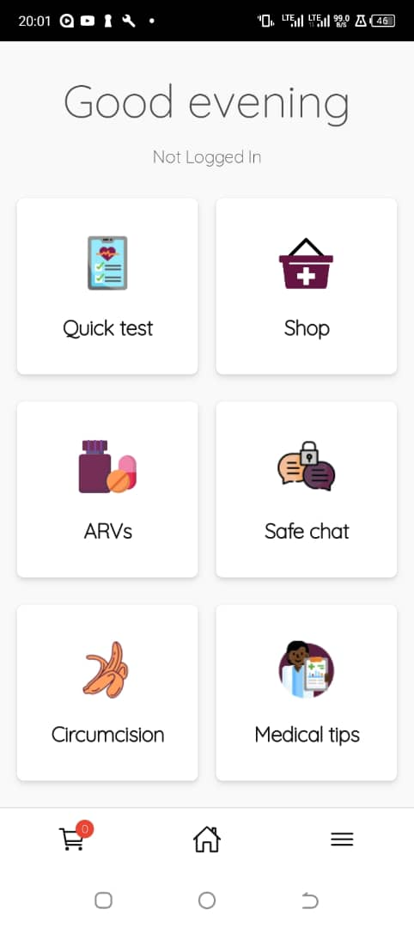
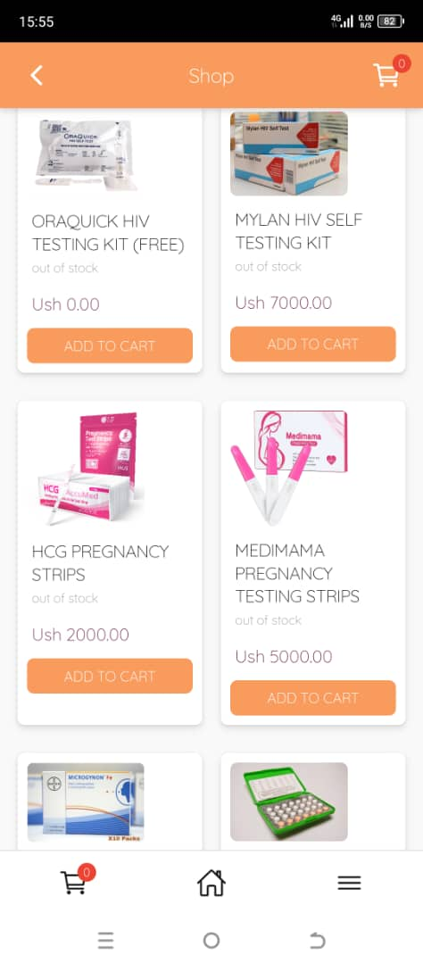
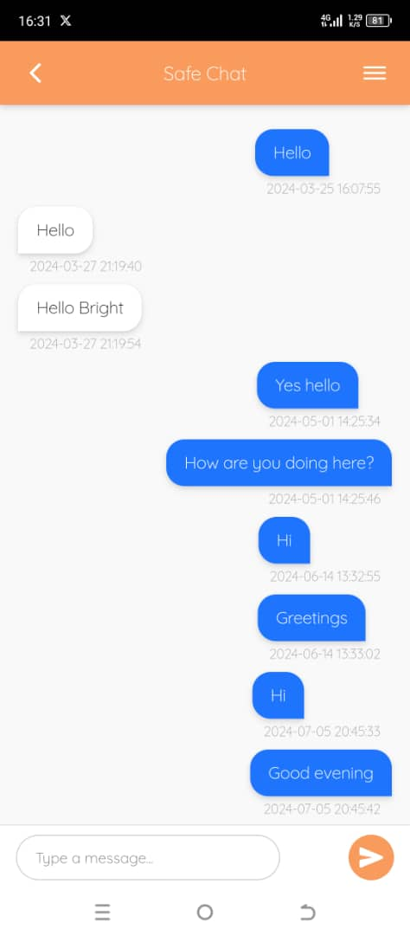
A look into the App

Slide 7
How It Works.
Wekume simplifies access to vital information and services related to sexual and reproductive health:
Download the app for free from Playstore.
Create a personalized profile.
Start a journey of information, resources, and support tailored to students’ needs.

Slide 8
OUR ASK
Collaborators and partners
Expand outreach and awareness.
Experts.
Funders/donors
Introductions
Technical development
Debugging
App security and data privacy
IOS version
USSD

Slide 9
Funding
What we have raised so far
Ugx 4,500,000/= ($1250)
Our goal: $34,000.
For Piloting: Feb 2025.
Branding: $5K
Marketing: $5K
Awareness: $2k
M&E: $5k
Incentives: $10K
Administrative: $7K

Slide 10
Our team
Joshua E Walusimbi. (CEO)
Bright Nseko ( Programs director)
Isabirye Nabikamba (Social media)
Stella Nabiryo (University coordinator)
Kulubya Leonard ( Partnership manager)
Derrick Ntubiro ( Events manager)
Bronwyn O’Hara (Donor impact )
Randy Burgoyne ( IT )

Slide 11



Contact Us:
Social Media:
TEL:
wekume
0784049640
wekume
0701117234
info@wekume.com
wekumeinfo@gmail.com
0753777984

Slide 12
THANK YOU FOR YOUR TIME

